Slide 1
Marijuana – United States
MCAS

Slide 2
Review – Single Convention Issue
Article 4
. . . limit exclusively to medical and scientific purposes the production, manufacture, export, import, distribution of, trade in, use and possession of drugs.
Article 36
. . . shall adopt such measures as will ensure that cultivation, production, manufacture, extraction, preparation, possession, offering, offering for sale, distribution, purchase, sale, delivery on any terms whatsoever, brokerage, dispatch, dispatch in transit, transport, importation and exportation of drugs contrary to the provisions of this Convention shall be punishable offences
Convention applies to Parties: Member Countries
United States is a Party to the Single Convention

Slide 3
U.S. Legal Structure
The United States has a two-tier government structure
Called “Federal” government system

Slide 4
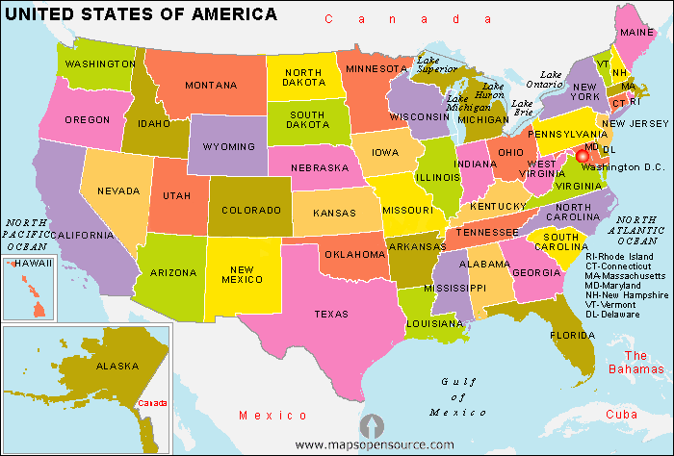

Slide 5
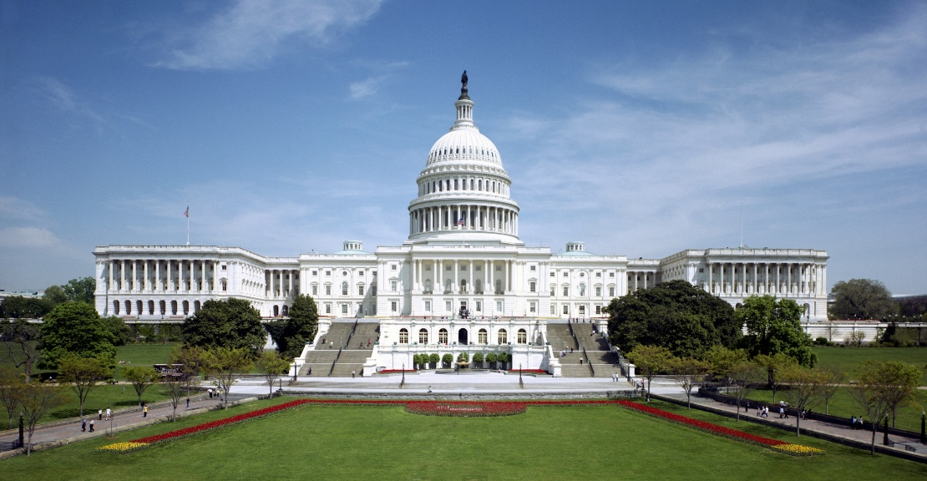
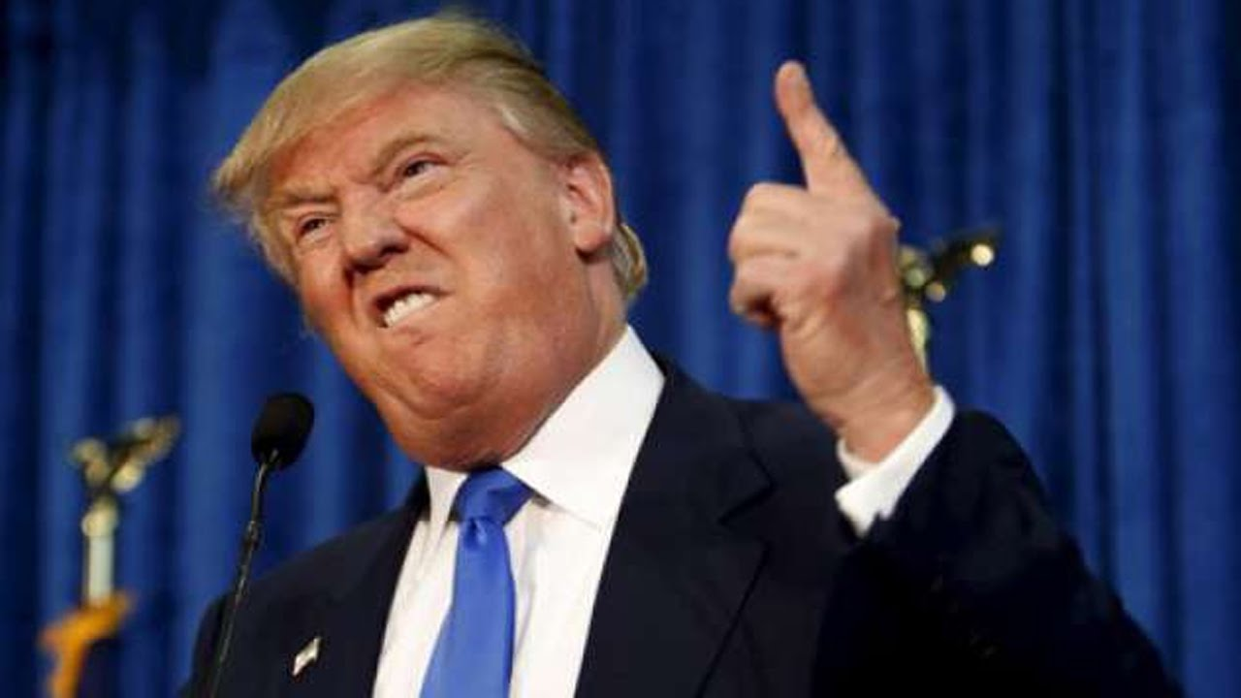
U.S. Legal Structure
National law (“federal law” is passed by Congress and governs the entire country)

Slide 6
U.S. Legal Structure
States have their own governments and laws governing their states, including criminal laws.
E.g. California has California state law.
As we have seen, Federal laws criminalize possession, distribution, trafficking, etc of illegal drugs.
States can also (and have) criminalize the same/similar drug offenses.
Remember 3 strikes? That was originally passed as California State law.

Slide 7
U.S. Legal Structure
So which law applies?
This is a very complicated area of law
Basic Concept:
Intrastate Activity – Regulated by State law
Activity that occurs wholly within a state or is a “traditional” area of state regulation
Interstate Activity – Regulated by Federal Law
Commercial activity that occurs across state borders or between states (interstate commerce)
Is it possible both laws apply? Yes, sometimes this is allowed.
Basic Rule:
The federal government can regulate something IF it is interstate activity or the activity effects interstate commerce

Slide 8
Federalism Example - Automobiles
State Law
Federal Law
Driver’s license
Car registration
Car inspection
Seat belt requirement
Car insurance mandate
Vehicle Safety Equipment
For example, requiring cars to have seatbelts/airbags
Fuel Emissions Standards
Highway design standards

Slide 9
Federal Law - Preemption
The Preemption Doctrine:
In some circumstances federal law preempts state law.
This means:
In case of conflict between the two, Federal law will be superior. The state law is void
Sometimes, ONLY Federal law can regulate the commercial activity. State law is not allowed
Example: Aviation standards and rules are only federal law

Slide 10
Federal Law on Drugs
The actual Federal Law regulating drugs of all kinds is the Controlled Substance Act (1970)
The CSA divides all drugs into various categories called “Schedules”, dividing between those drugs that have a medical purpose and those drugs that do not.
There are 5 categories (Schedules I to V)
Schedule V – Over-the-counter (“OTC”)
Schedule II – drugs with a high potential for abuse, with use potentially leading to severe psychological or physical dependence.
Schedule I – no currently accepted medical use and a high potential for abuse.
Doctors get a license from the DEA to in order to make prescriptions
CSA preempts any and all state law related to drug approval, classification, and oversight (manufacturing, distribution, etc).

Slide 11
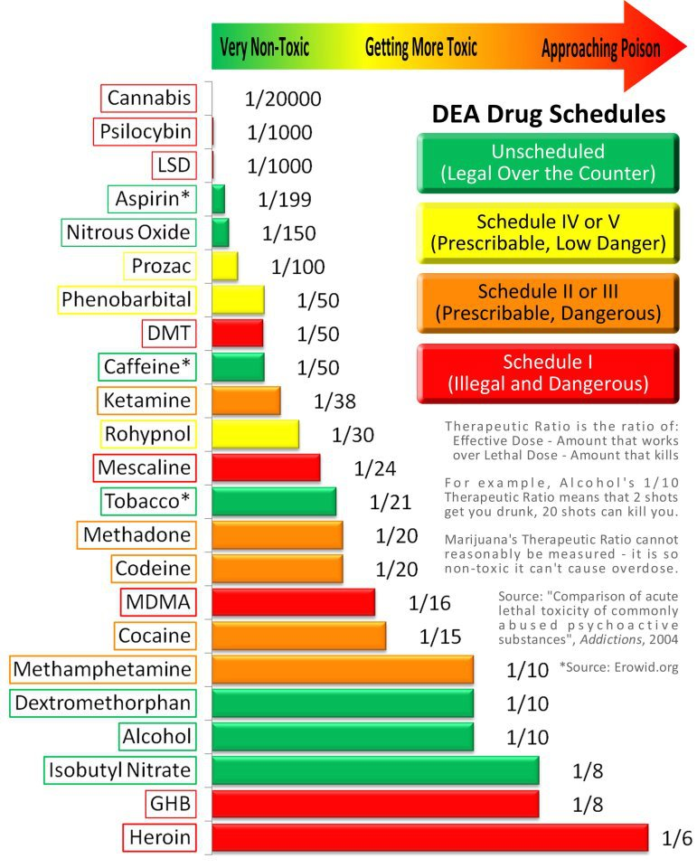
Controlled Substances Act

Slide 12
Legalization – Medical Marijuana
In 1996, California became the first state to legalize marijuana usage for medical purposes.
The law’s focus is on the use of Marijuana for medical purposes only, not recreational uses.
It seeks to protect three classes of individuals:
Seriously ill patients requiring the use of marijuana
Primary caregivers – person who may assume responsibility of caring for the patient
Doctors – for recommending the use of marijuana

Slide 13
California – Medical Marijuana
How it works
The patient must get a letter of recommendation from the physician.
NOT a prescription. Why?
Prescriptions for Schedule I drugs by doctors is illegal under federal law.
Patient/Caregiver can either
Grow their own plants
Join a members co-operative and buy marijuana from the co-operative.
Limited to a reasonably supply for personal use (approx. 60 days)

Slide 14
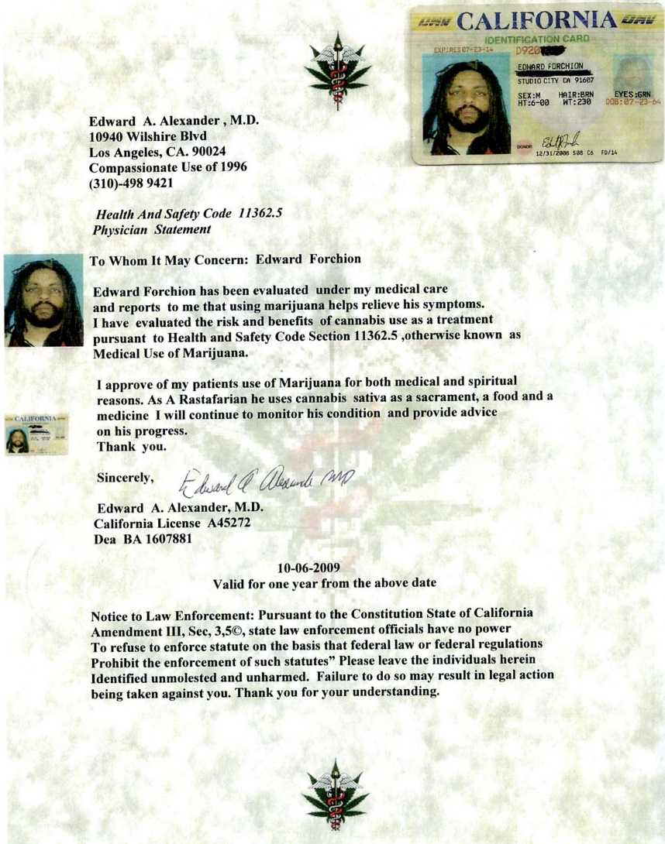

Slide 15
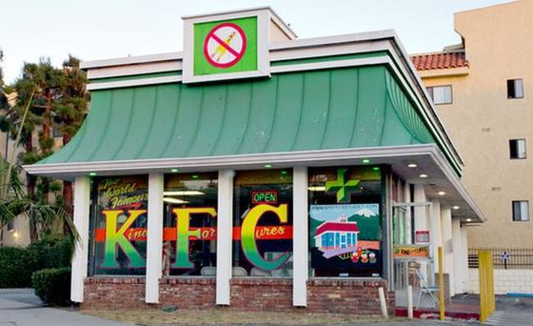
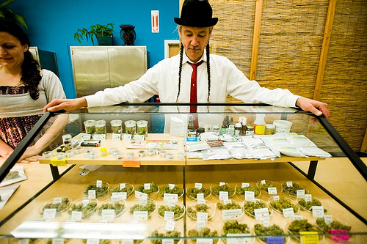

Slide 16
Federal Supremacy - Gonzales v. Raich
U.S. Supreme Court rules on relationship between State drug laws and Federal law (2005)
Mr. Angel Raich used homegrown medical marijuana.
Federal agents seized and destroyed all his marijuana plants.
“[T]he regulation is squarely within Congress' commerce power because production of the commodity meant for home consumption . . . has a substantial effect on supply and demand in the national market for that commodity.”

Slide 17
Full Legalization of Marijuana
In 2012, States of Washington and Colorado legalized recreational usage of Marijuana. 2014: Oregon & Alaska
For example, in Colorado: production and selling of marijuana is regulated by the state government, including licensing, inspections, and taxing sales.

Slide 18
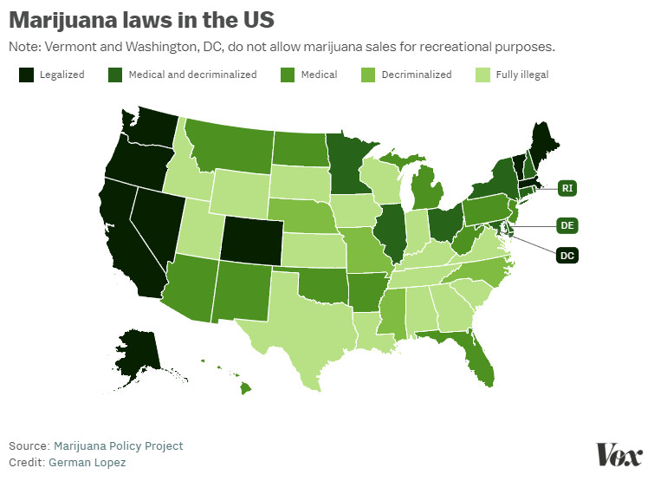
Legalization of Marijuana

Slide 19
Federal Supremacy Issues
So, being a fully licensed and legal business selling Marijuana (e.g. in Colorado/Washington) is still a violation of federal drug laws (e.g. distribution).
Does it affect interstate commerce? Under Raich standard→ YES.
Proceeds from marijuana sales?
Can’t use banking services (Illegal for banks to process the funds as money laundering)
Taxes from marijuana sales?
Sellers have to pay income tax to the federal government
Could the federal government seize the states’ tax revenues?
2016: Colorado made USD $200 million in tax revenue from sale of marijuana.

Slide 20
Single Convention Narcotics 1961
Does medical marijuana law violate the Single Convention’s obligations?
Does state (e.g. Colorado) law legalizing recreational marijuana violate the Single Convention?
http://www.incb.org/documents/Publications/PressRelease/PR2013/press_release140313.pdf

Slide 21
Decriminalization – A third way?
2017 Consolidated Appropriations act:
SEC. 537. None of the funds made available in this Act to the Department of Justice may be used . . . to prevent any of [the states with medical marijuana] from implementing their own laws that authorize the use, distribution, possession, or cultivation of medical marijuana.

Slide 22
The Board reiterates its view that measures taken in various states of the United States to legalize the production, sale and distribution of cannabis for nonmedical and non-scientific purposes are inconsistent with the provisions of the international drug control treaties.
INCB wishes once again to draw attention to the fact that the 1961 Convention as amended establishes that the parties to the Convention should take such legislative and administrative measures as may be necessary “to limit exclusively to medical and scientific purposes the production, manufacture, export, import, distribution of, trade in, use and possession of drugs”.

